Slide 1
.Net TraiNING Week 3

Slide 2
AGENDA
Introduction to WEB API
What is API
Understanding WEB API folder structure
Working with Controllers and Action methods
Http Verbs (Get, Post)
Creating an API in .NET Core
Return Types
Routing
Testing/Debugging API from Postman/Swagger

Slide 3
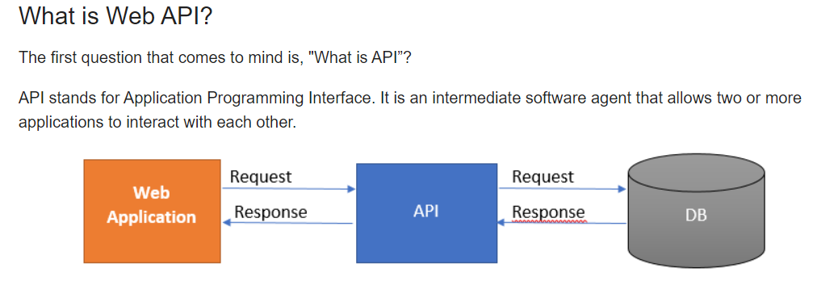
API
API-Application Programming Interface

Slide 4
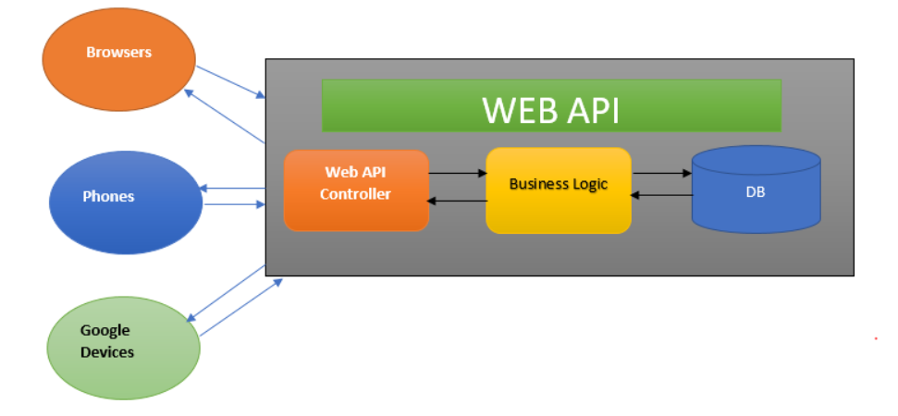
Working of API

Slide 5
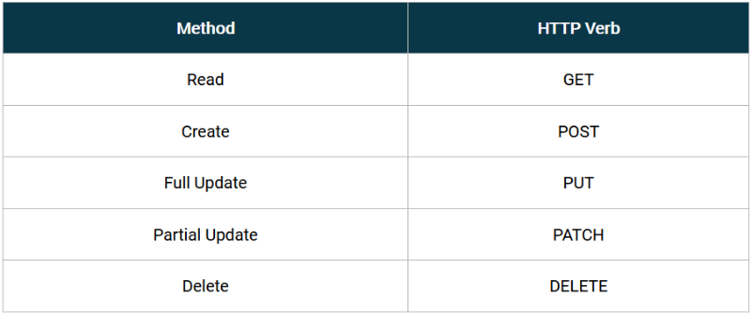
HTTP Verbs

Slide 6
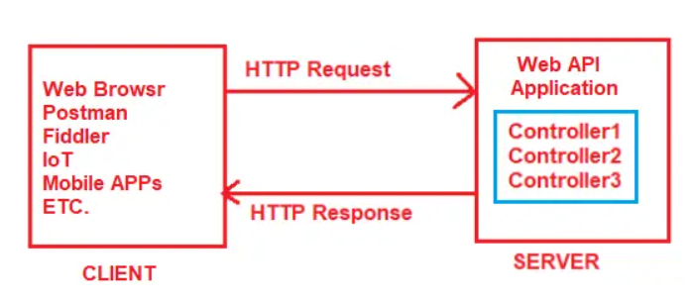
Routing in ASP.NET Core Web API
Routing in ASP.NET Core Web API application is the process of mapping the incoming HTTP Request (URL) to a particular resource i.e. controller action method.

Slide 7
IActionResult
provides a flexible way to return various types of results.

Slide 8
Thank You

